Slide 1
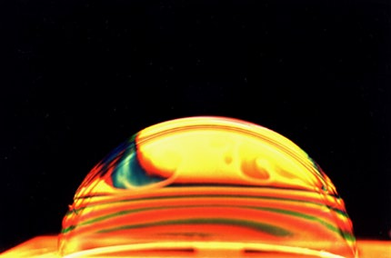
SOAPS & DETERGENTS

Slide 2

Production of Soaps

Slide 3

Production of Soaps

Slide 4
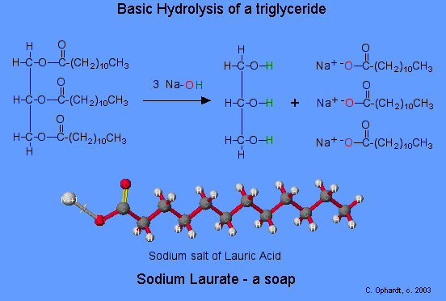

Slide 5


Production of Detergents
Sulfonation of alkylbenzene
Conc.
R
R
Neutralisation of alkylbenzene sulfonic acid
NaOH
Eg.

Slide 6
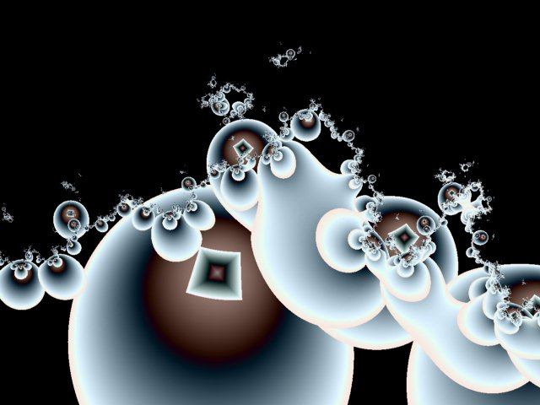
HOW SOAPS & DETERGENTS WORK

Slide 7

‘Water-loving’, Polar
‘Water-hating’, Non-polar
Both detergents & soaps have a polar group (usually negatively charged) and a non-polar hydrocarbon chain. The polar end dissolves readily in water while the non-polar hydrocarbon chain dissolves readily in other non-polar substances, Eg. oil & grease

Slide 8



Anionic surfactants have a hydrophilic head consisting of a negatively charged group. These are the most common types of surfactant. They are cheap and perform well.
Cationic surfactants have a positively charged group as their hydrophilic head. Some have germicidal properties
Detergent

Slide 9
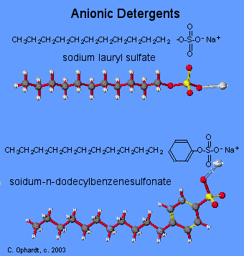
Anionic surfactants have a hydrophilic head consisting of a negatively charged group. These are the most common types of surfactant. They are cheap and perform well.

Slide 10
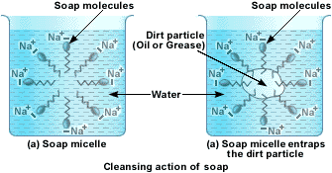

Slide 11
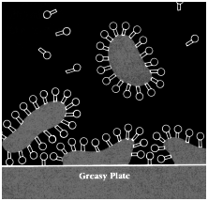

Slide 12
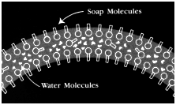
Bubble Formation

Slide 13
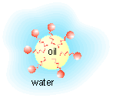
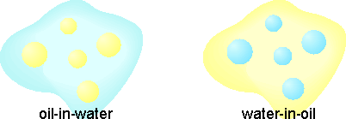
Emulsions

Slide 14
SOAPS V’s DETERGENTS
1. Soap cannot be used in hard water.
1. Synthetic detergents can be used in hard water.
2. Soap is made from expensive vegetable/edible oils.
2. Synthetic detergents are made from by-products of petroleum industry.
3. Soaps cannot be used in acidic medium as this would precipitate the fatty acids.
3. Synthetic detergents can be used in any medium including acidic medium.
4. Soaps have weak cleansing action.
4. Synthetic detergents have strong cleansing action.
5. Soaps are not very soluble in water.
5. Synthetic detergents are highly soluble.
6. Soaps are biodegradable and do not cause any pollution.
6. Some synthetic detergents are not biodegradable and may cause water pollution.

Slide 15
End of Slide Show
To Return to Year 12 Tutorial List
Choose Back from Menu above

